Slide 1
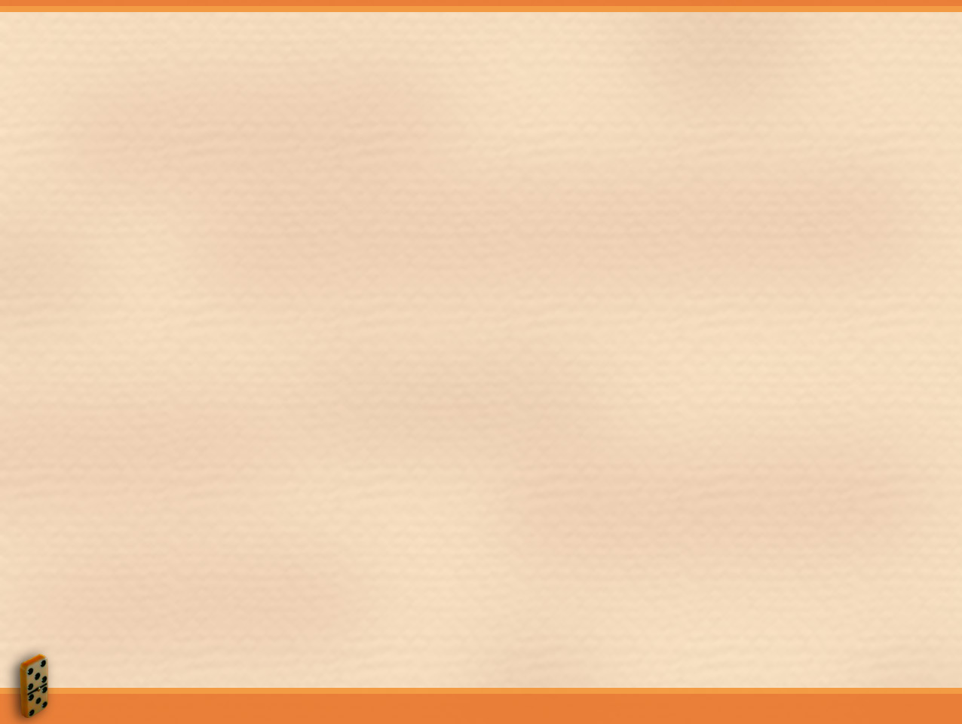
How Would You Define a Group?
Two or more people who interact regularly to accomplish a common purpose or goal.
Groups are a ubiquitous part of organizational life.
Types of Groups
Formal or Functional Group:
  A permanent group created by the organization to accomplish a number of organizational purposes with an indefinite time horizon.
Task Group: accomplish a relatively narrow range of purposes within a stated or implied time horizon.
Informal or Interest Group:
  Created by its own members for purposes that may or may not be relevant to organizational goals.

Slide 2
Types of Teams
Group of workers that functions as a unit, often little of no supervision, to carry out org. functions
Problem-solving team:
  Comprises knowledge workers who gather to solve a specific problem.
Management team:
  Consists mainly of managers from various functions.
Work team:
  Responsible for the daily work.
Virtual team:
  New form of team that interacts by computer.
Quality circle:
  Declining in popularity.

Slide 3
How Do People Join Groups?
They join functional groups simply by working for an organization.
When an employee is assigned a job they become members of a functional group.
Then employees volunteer to serve on: committees, task forces, and teams.
They also join informal interest groups.

Slide 4
Stages of Group Development
Forming:
Members get
acquainted, test
interpersonal
behaviors
Slow evolution
to next stage
Storming:
Members develop
group structure &
patterns of
interaction
Burst of activity to
next stage
Slow evolution
to next stage
Performing:
Members enact roles,
Direct effort toward
goal attainment
and performance
Norming:
Members share
acceptance of roles,
sense of unity

Slide 5
Characteristics of Groups and Teams
Role, Norms, Cohesiveness
Role
  The part an individual plays in helping the group reach its goal.
What does role structure accomplish?
  The set of defining roles and interrelationships among those roles that the group or team members define and accept.
  Role Development
  Expected Role Sent Role Perceived Role
  Enacted Role

Slide 6
Role ambiguity:
  When the sent role is unclear and the individual does not know what is expected of them.
Role conflict:
  When the messages and cues comprising the sent role are clear but contradictory or mutually exclusive.
Role overload:
  When expectations for the role exceed the individual’s capabilities.

Slide 7
Behavioral Norms
Norms are standards of behavior that the group or team accepts for its members.
What do norms define?
  Boundaries between acceptable and unacceptable behavior.
  Norm Conformity
Some groups or teams exert more pressure for conformity.
Initial stimulus that prompts behavior can affect conformity.
Individual traits can determine conformity.
Situational factors such as team size contribute to conformity.
Socialization
Generalized norm conformity that occurs as a person makes the transition from being an outsider to being an insider in the organization.

Slide 8
Factors That Influence Group Cohesiveness
Factors that increase cohesiveness:
  Inter-group competition.
  Personal attraction.
  Favorable evaluation.
  Agreement on goals.
  Interaction.
Factors that reduce cohesiveness:
  Group size.
  Disagreement on goals.
  Intra-group competition.
  Domination.
  Unpleasant experiences.

Slide 9
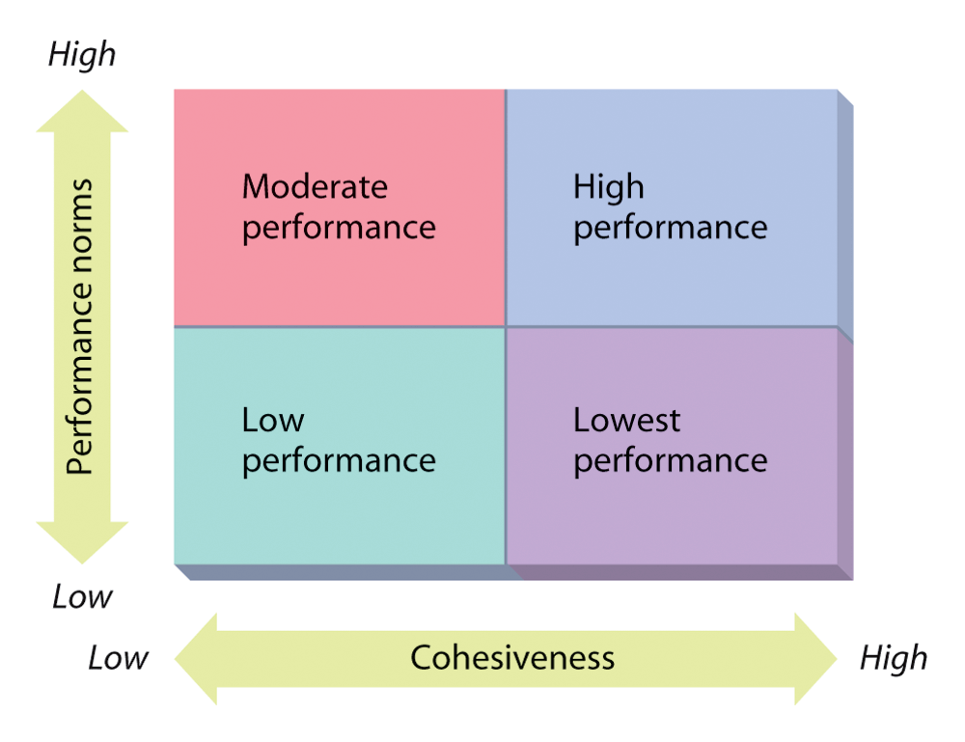
The Interaction Between Cohesiveness and Performance Norms

Slide 10
Formal and Informal Leadership
Formal leadership:
  One appointed by the organization or chosen or elected by members of the group.
Informal leader:
  A person who engages in leadership activities but whose right to do so has not been formally recognized by the organization or group.

Slide 11
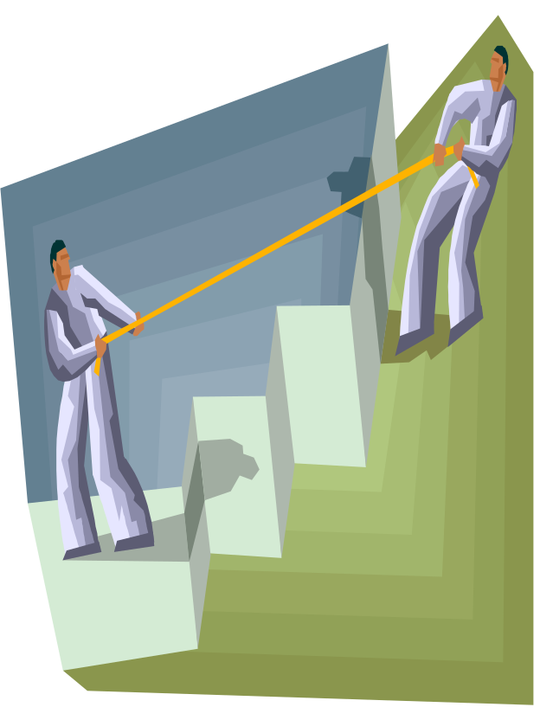
The Nature of Conflict
Define conflict?
  A disagreement between two or more:
    Individuals.
    Groups.
    Organizations.

Slide 12
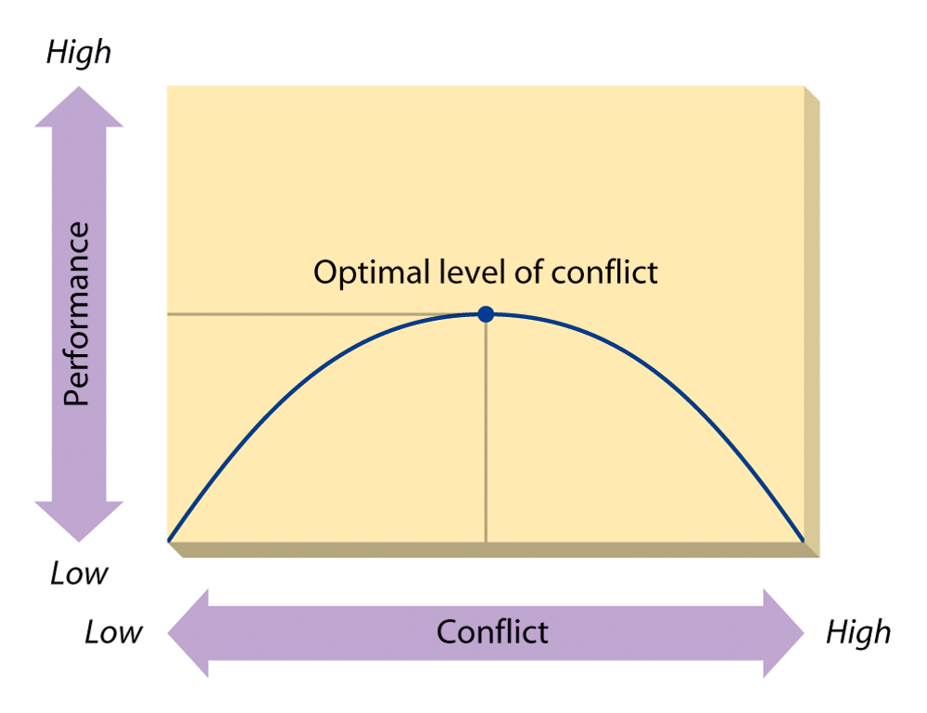
The Nature of Organizational Conflict

Slide 13
Managing Conflict
Stimulating conflict:
  Increase competition
  Hire outsiders
  Change established procedures
Controlling conflict:
  Expand resource base
  Enhance coordination of interdependence
  Set supra-ordinate goals
  Match personalities and work
Avoid conflict
Convince conflicting parties to compromise.
Bring conflicting parties together to confront and negotiate conflict.

